Slide 1
1. Introduction to R and R Studio

Slide 2
Getting Started - RStudio

Slide 3
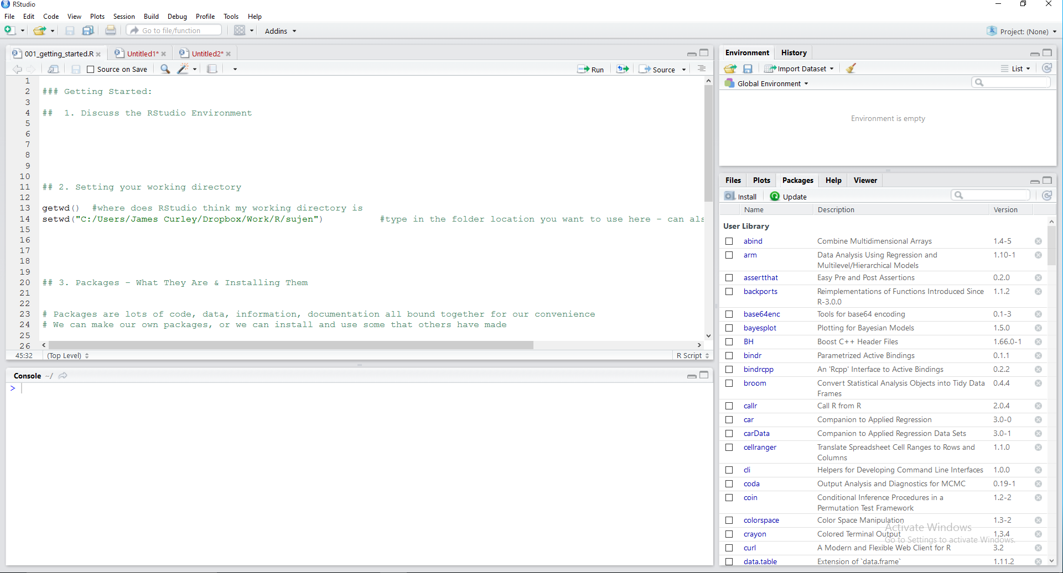
The Rstudio Environment

Slide 4
Environment – where data, functions, objects are located
History – where past code is located
Import Dataset tab – import data from file
Files tab – shows current folder location
Plots tab – shows current graphics plot
Packages tab – shows currently installed packages
Help – documentation and help guide
Viewer – alternative graphics interface e.g. for HTML graphics
Console –code input, past code and returned output from functions
Scripts Window – current script files
Other RStudio menu features
RStudio Addins tab

Slide 5
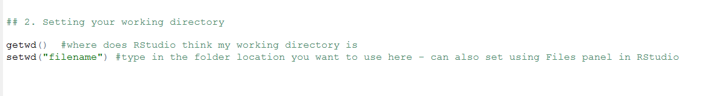
Working Directories - what are they and how do they help you ?
This tells RStudio which folder you consider to be the ‘home’ location – it will be where it will go searching for files
You can set using the function “setwd()” or you can set using the RStudio interface

Slide 6
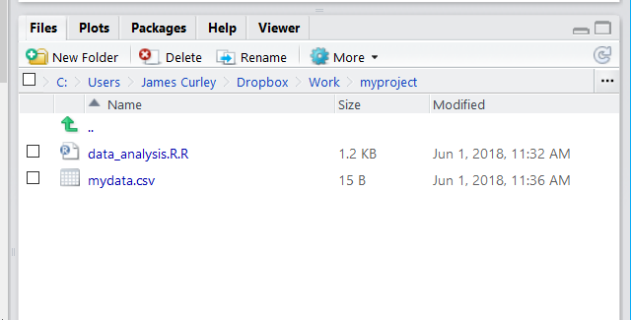
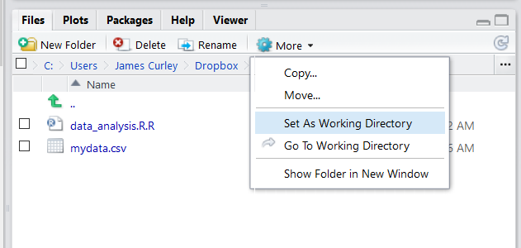
Use the three dots icon “…” to browse for your folder you wish to be the working directory
Use the wheel icon to “Set As Working Directory”

Slide 7
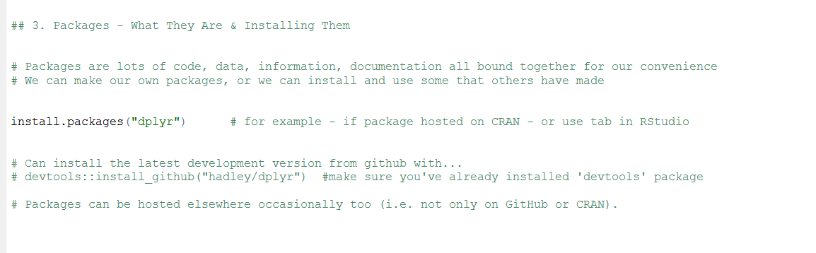
Packages - what are they and how do they help you ?

Slide 8
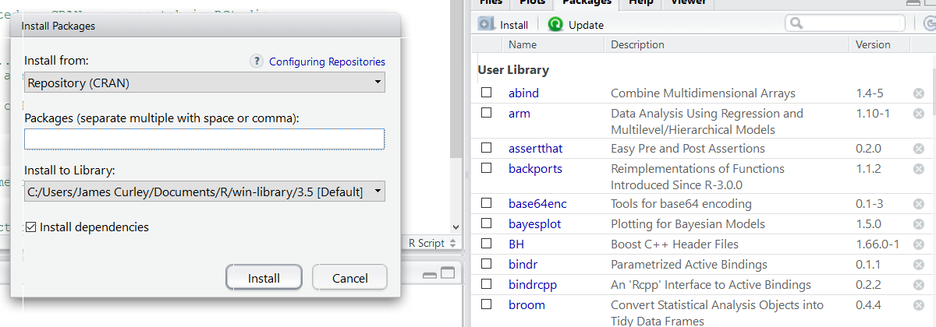
Use the install icon to open up the Install Packages menu window.

Slide 9
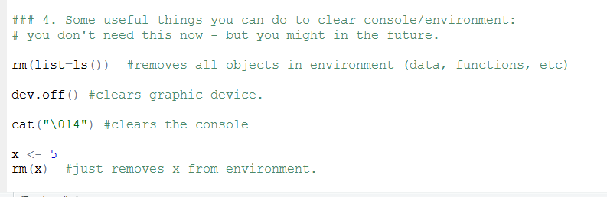
Some useful functions – these are here for reference (you may wish to use them at some point !)
You don’t need to remember them - just come back and copy/paste them when needed.

Slide 10
1a. Importing and Exporting Data into R Studio

Slide 11
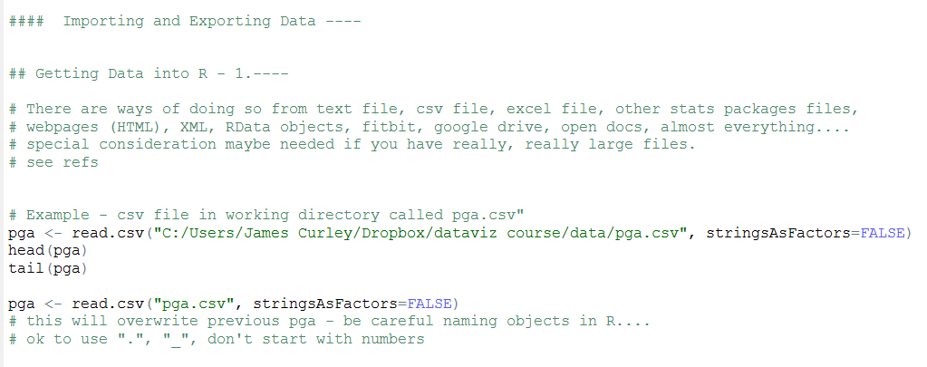
Importing a CSV file: read.csv()

Slide 12
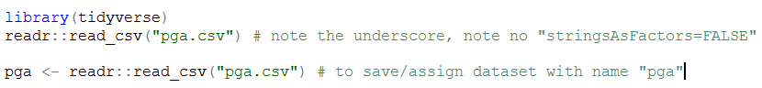
Importing a CSV file: readr::read_csv()
“readr” is a package that is installed with the “tidyverse” suite of packages.
To call a specific function from a specific package we use the double colon between the package and function names.
If you load the library, you do not need to do this. I’m doing it throughout so that you can see which function comes from which library

Slide 13
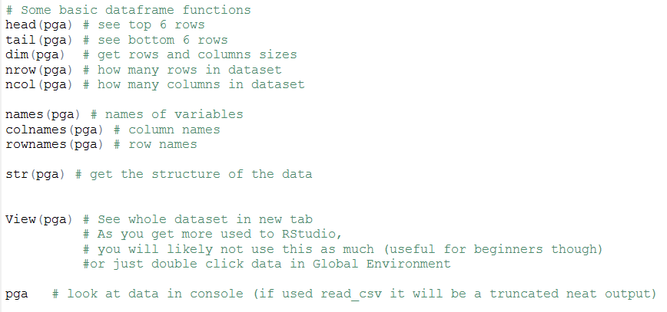

Slide 14
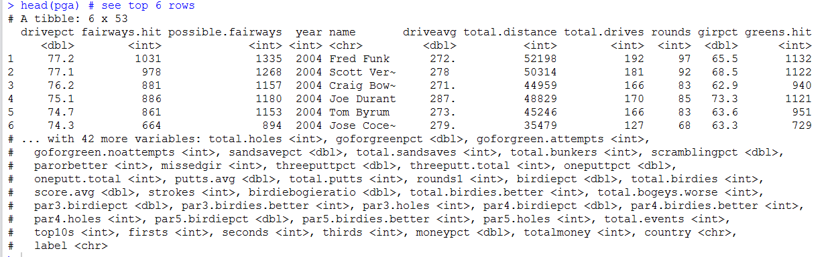

Slide 15
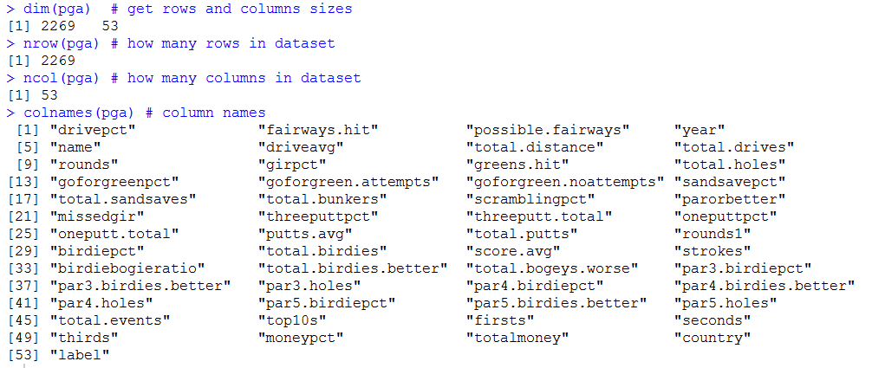

Slide 16
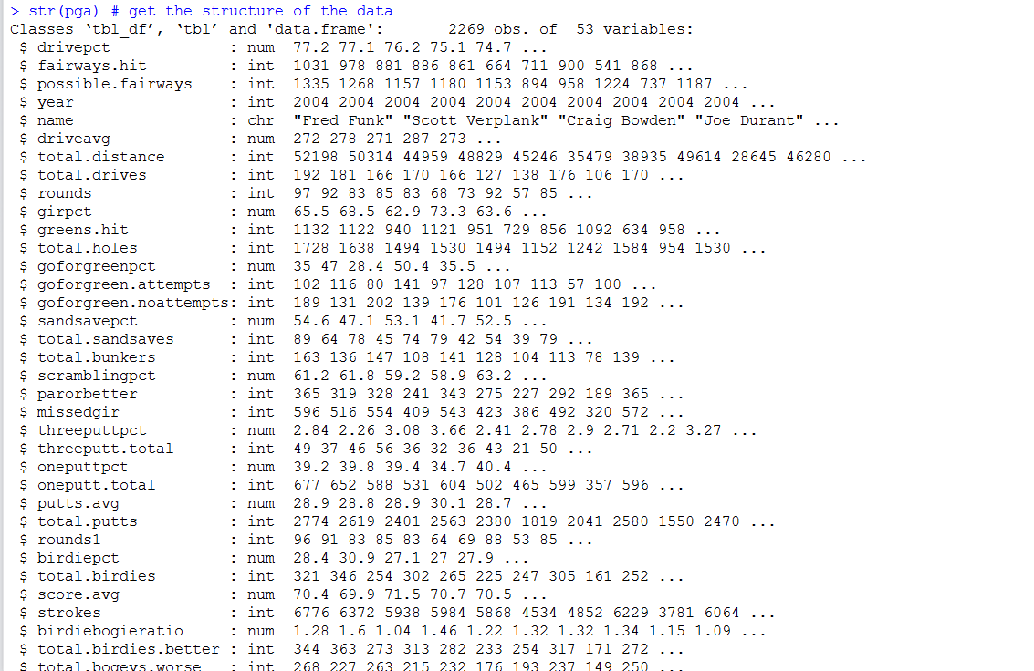

Slide 17
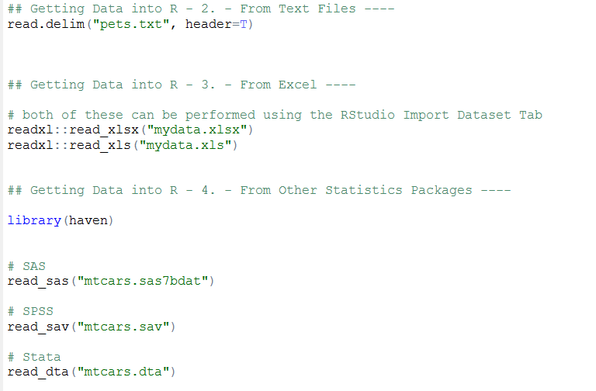
Basically data in any form can be imported into Rstudio – see REFS for more information

Slide 18
Data from websites:
CSV, txt, JSON, HTML, etc. – all manner of data hosted on websites can directly be read into Rstudio

Slide 19
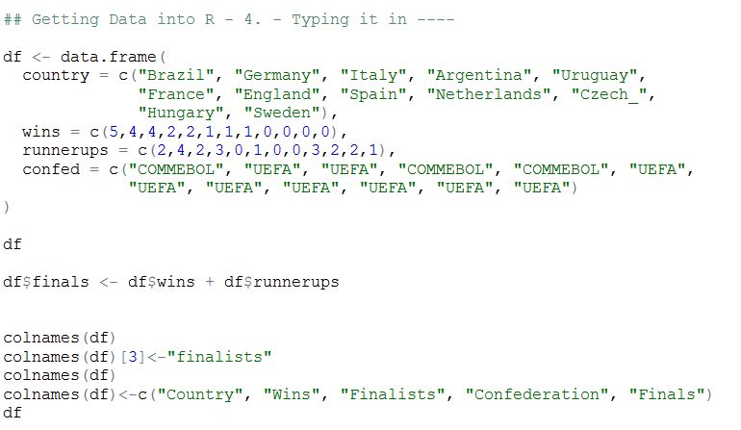
Directly entering data into a dataframe structure using function data.frame()
c() is a function that creates a vector of things – could be numbers, text, both

Slide 20
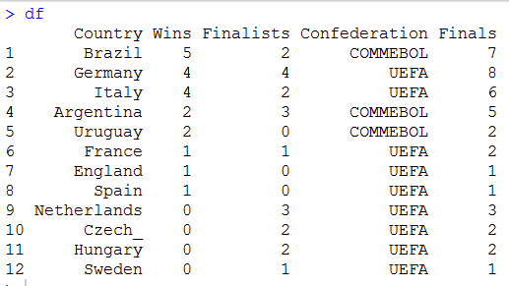

Slide 21
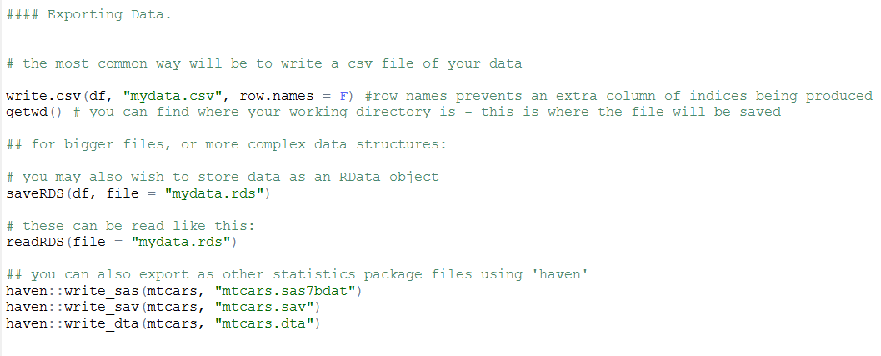
Exporting Data means writing a file to your working directory

Slide 22
1b. Working with Data in RStudio

Slide 23
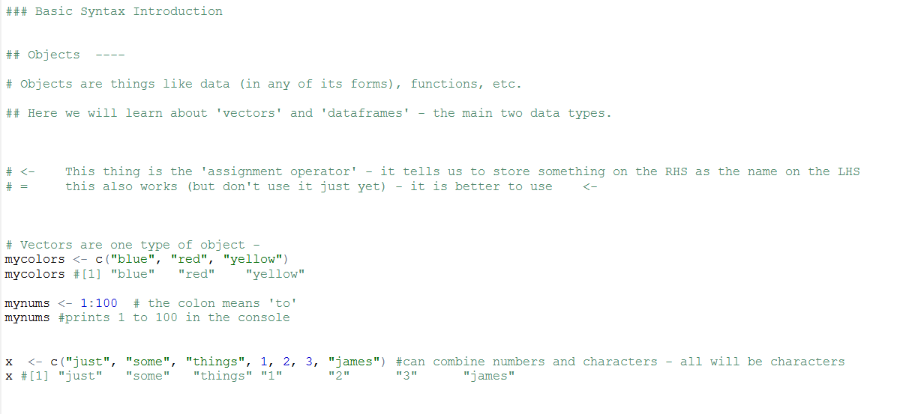
Some basic R Syntax - what are vectors ?

Slide 24
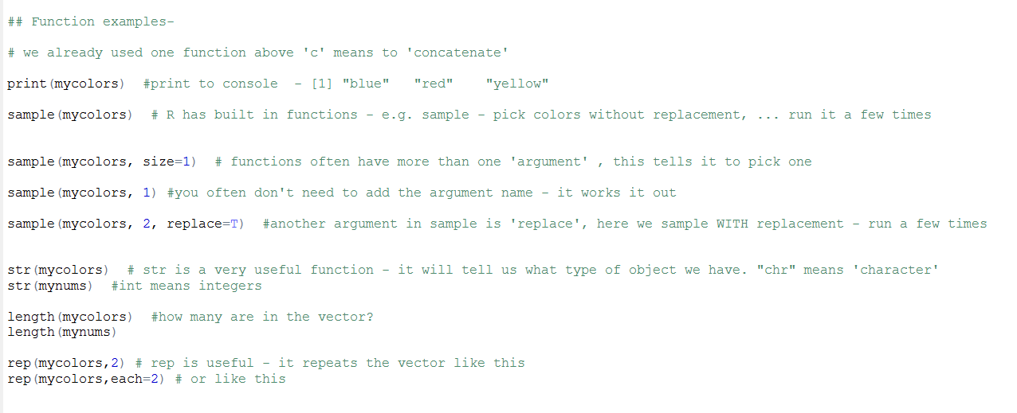
Some basic R Syntax - what are functions ?

Slide 25
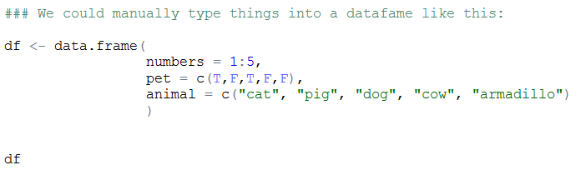
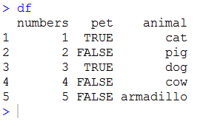
Recap some basic R Syntax - what is a dataframe?

Slide 26
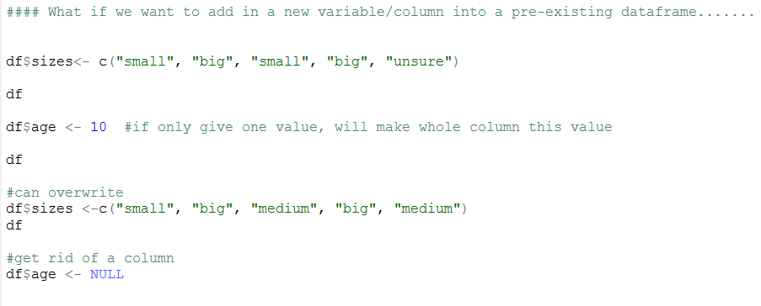
Adding and removing columns/variables from a dataframe

Slide 27
Working with dataframes in base-R

Slide 28
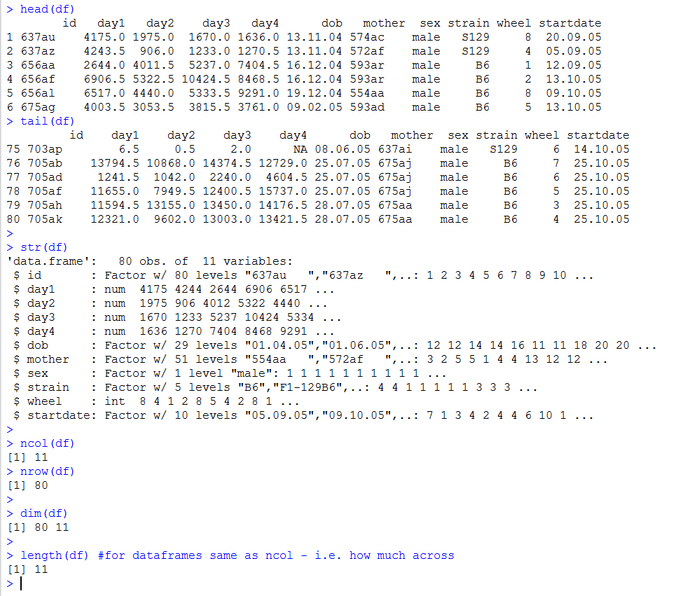
Example dataset is the ‘wheels.csv’ file

Slide 29
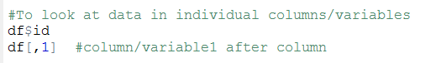
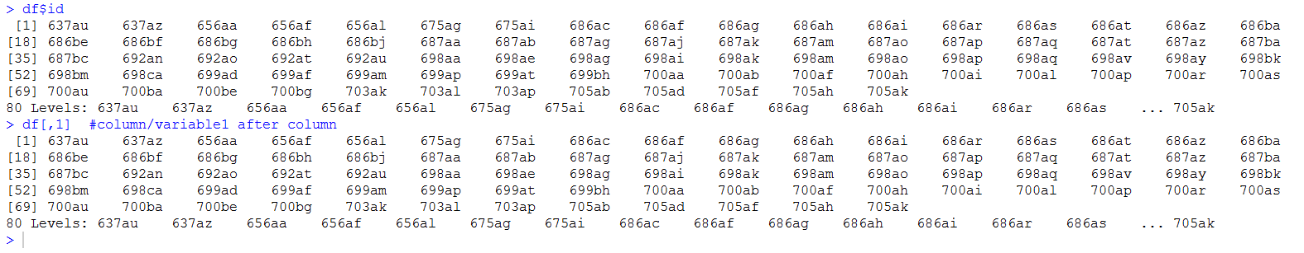

Slide 30
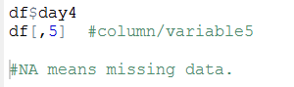
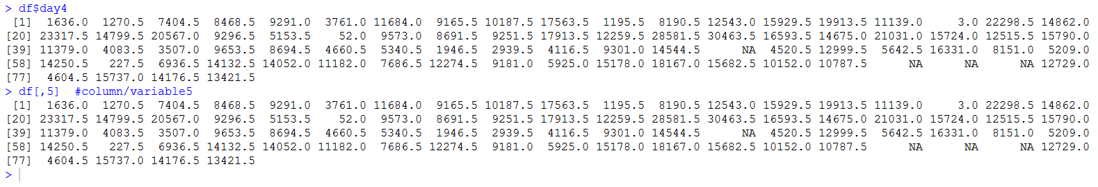

Slide 31
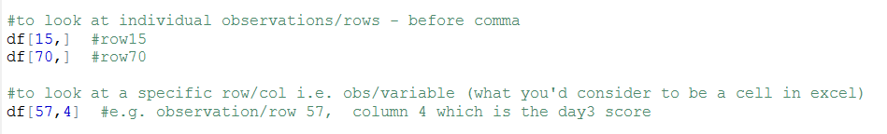
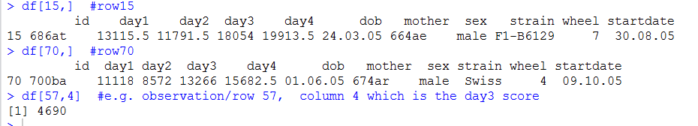

Slide 32
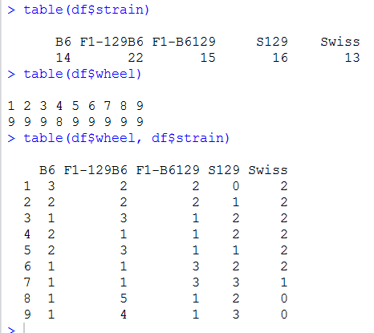
table() is a useful function for getting quick summaries of frequencies of data

Slide 33
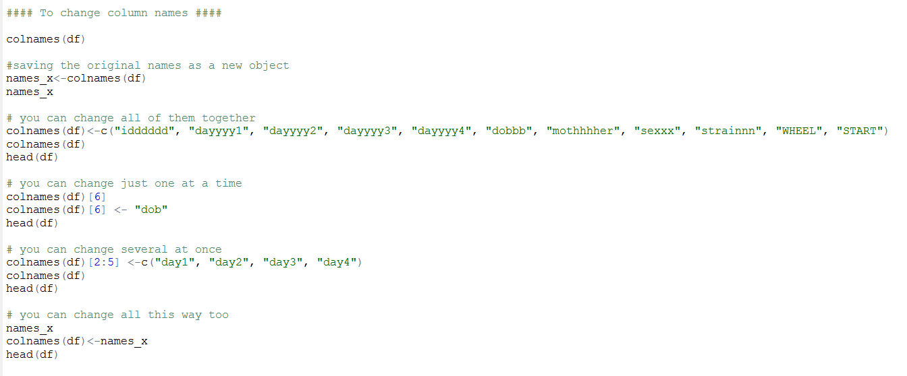
Changing column/variable names

Slide 34
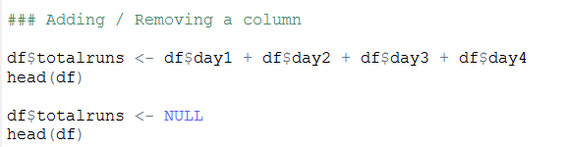
Adding removing columns

Slide 35
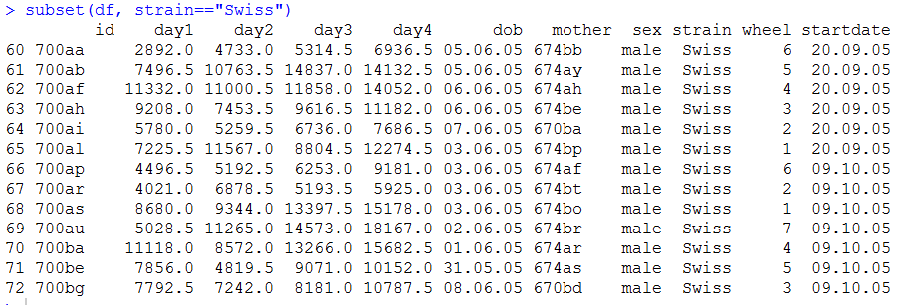
Subsetting data

Slide 36
Descriptive Statistics – quick summaries

Slide 37
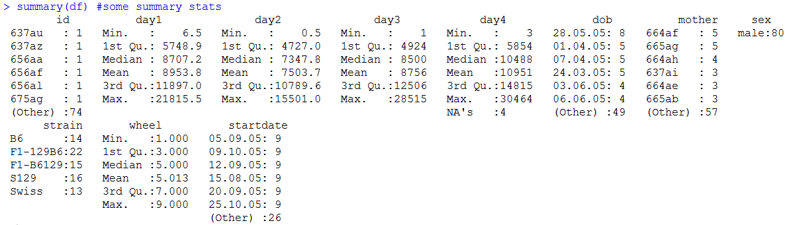
summary() gives a quick snapshot:

Slide 38
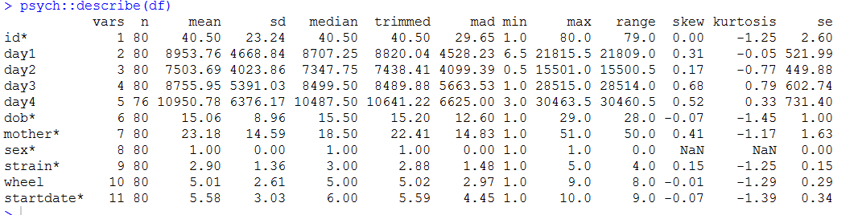
describe() from ‘psych’ gives more info quickly:

Slide 39
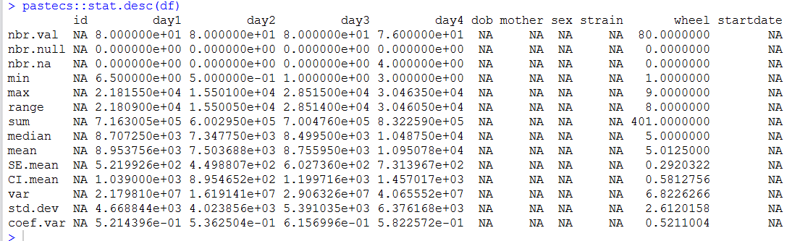
stat.desc() from ‘pastecs’ can be useful too (although not so much here):

Slide 40
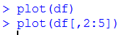
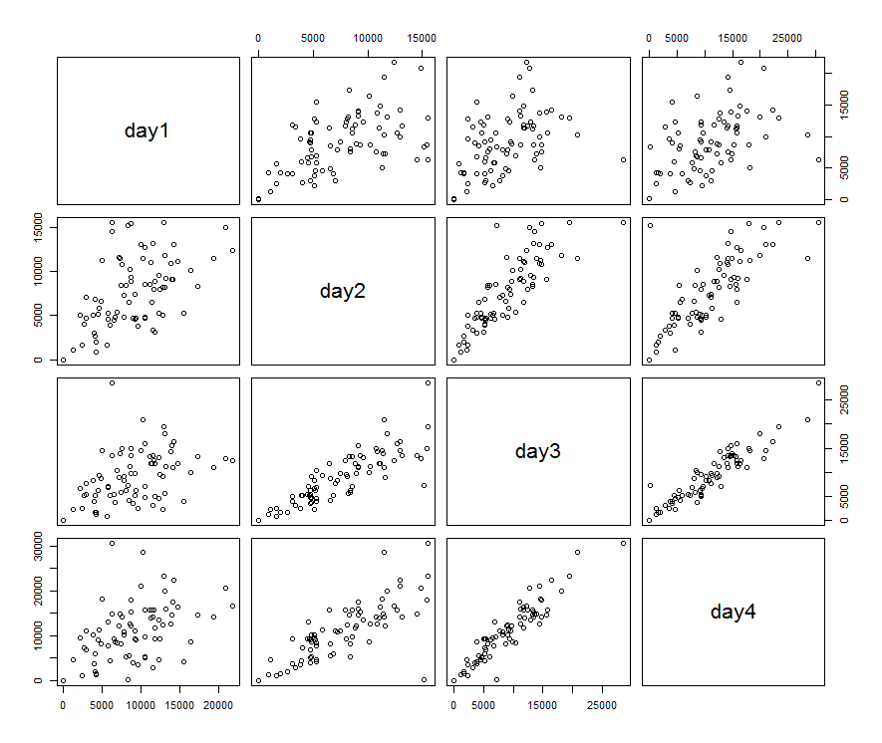
Can use plot() to get quick snapshots of the relationships between variables – more on this in the visualization section

Slide 41
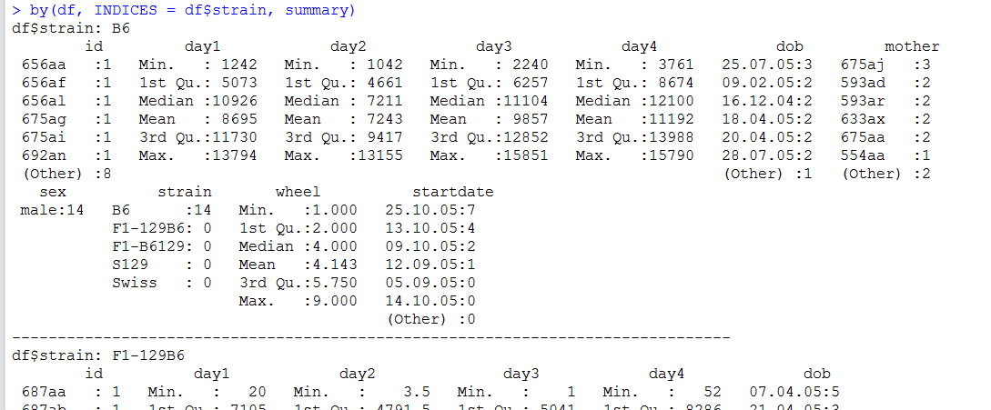
Use by() to get summary data for each group

Slide 42
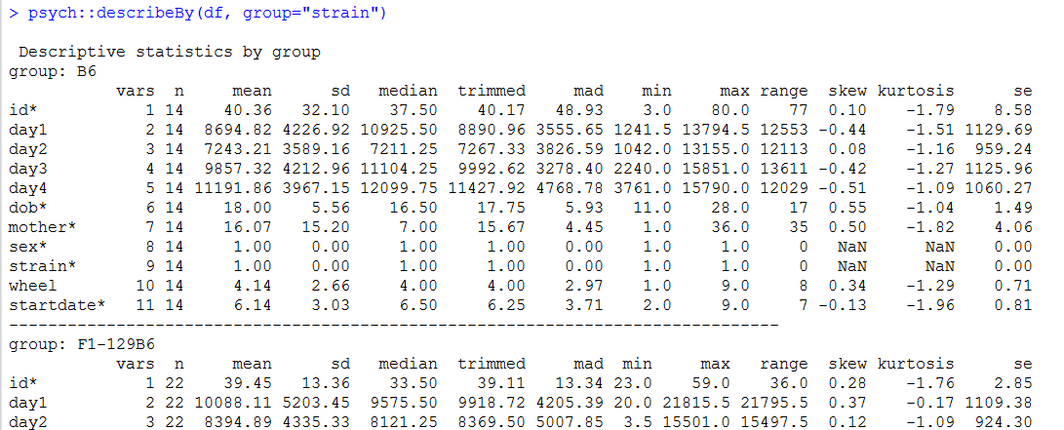
describeBy() from ‘psych’ allows you to do by group:

Slide 43
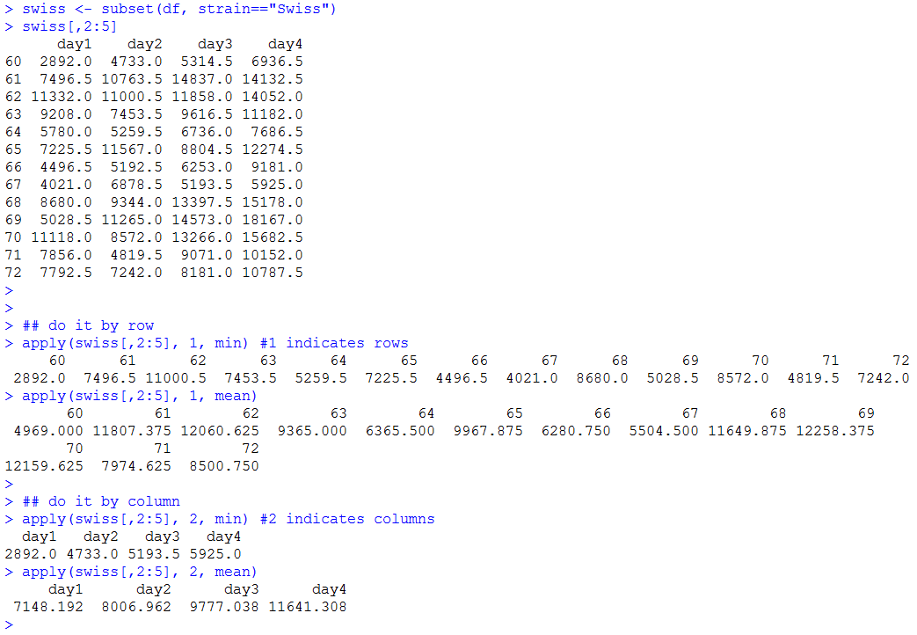
Can use apply() to get summaries across columns or rows

Slide 44
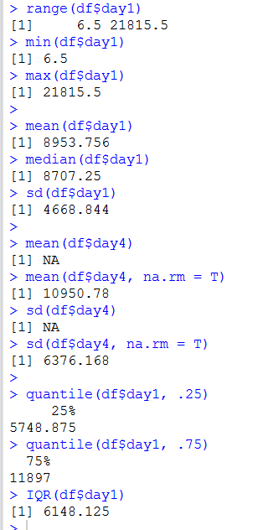
Some of the most common descriptive statistics functions in R
Note that if there are missing data in a variable, then some functions cannot compute this – they require you to add “na.rm=T” to remove missing values from the calculations

Slide 45
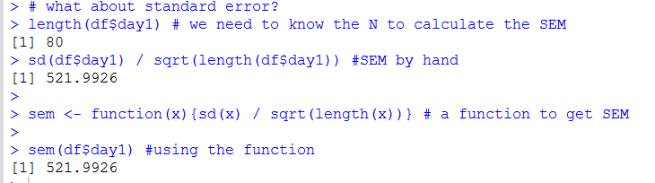
Standard Error
This is easy to calculate ‘by hand’ in R, but for some reason there is no base-r function for it.
We can write our own function – or use the functions available in e.g. psych package.

Slide 46
1c. Data Management and Cleaning

Slide 47
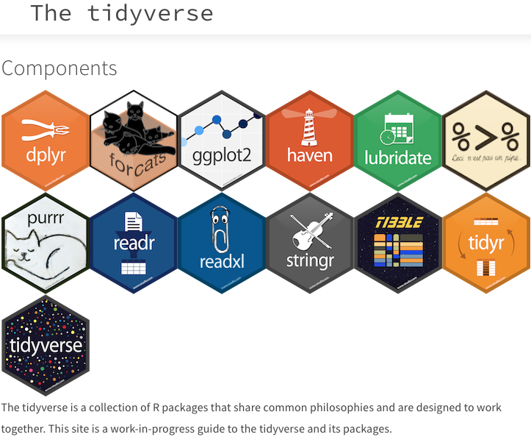

Slide 48
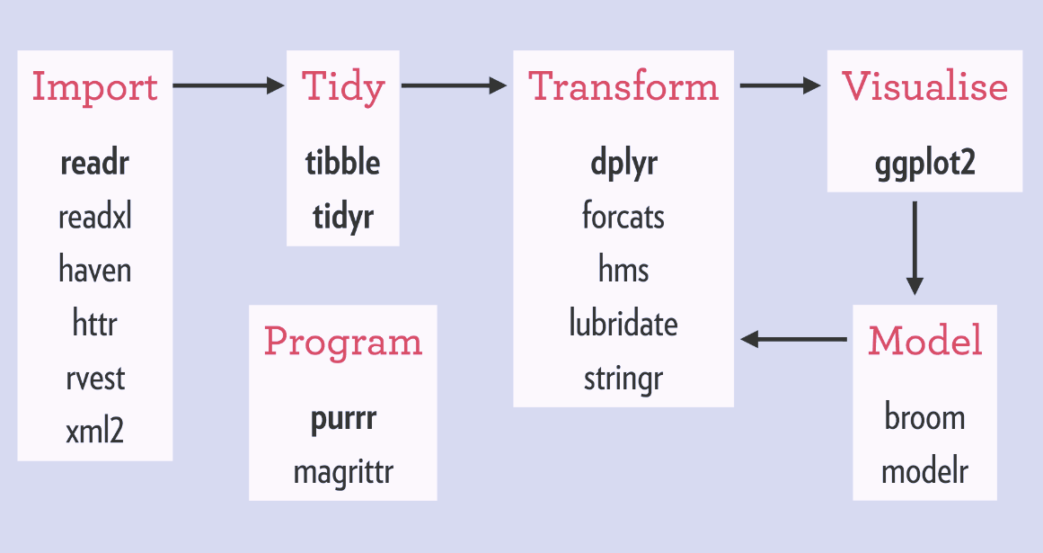

Slide 49
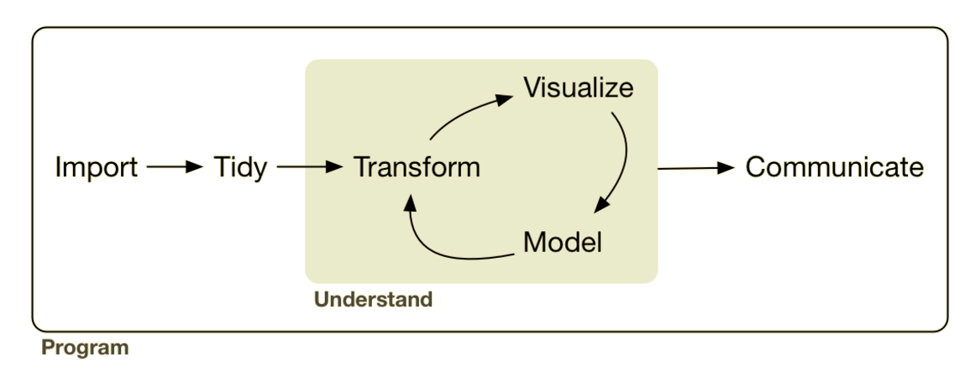

Slide 50


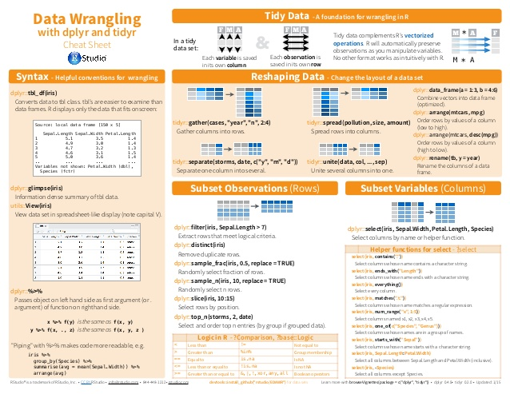
See Rstudio dplyr / tidyr cheatsheet handout

Slide 51

“Tidy” Data
Data Science with R - Garrett Grolemund

Slide 52
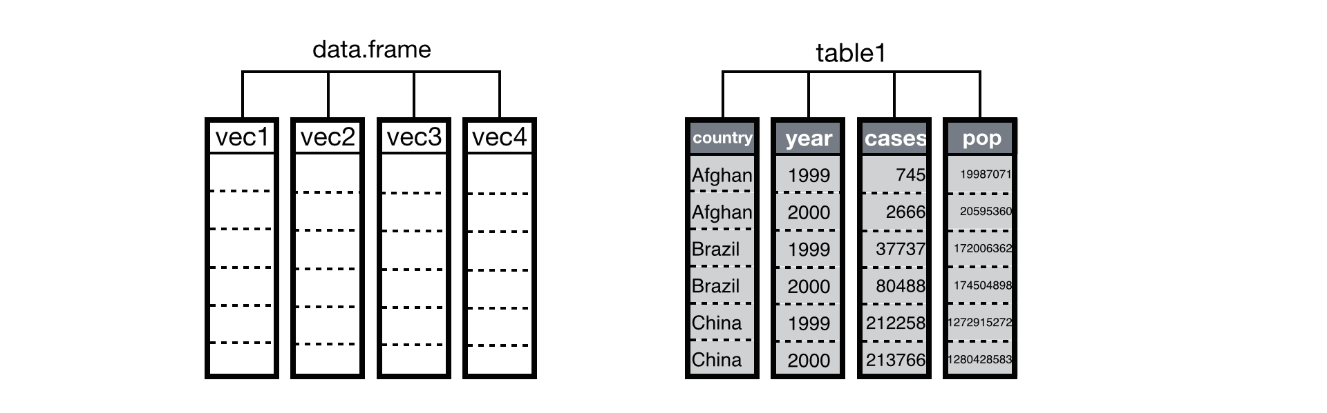
“Tidy” Data
Data Science with R - Garrett Grolemund

Slide 53
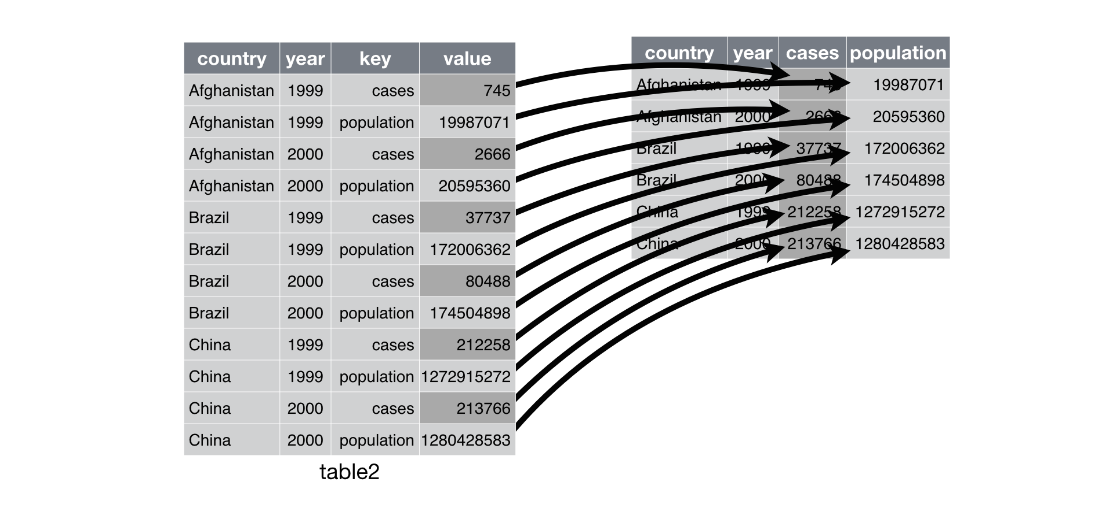
“Untidy” Data
“Tidy” Data
Data Science with R - Garrett Grolemund

Slide 54
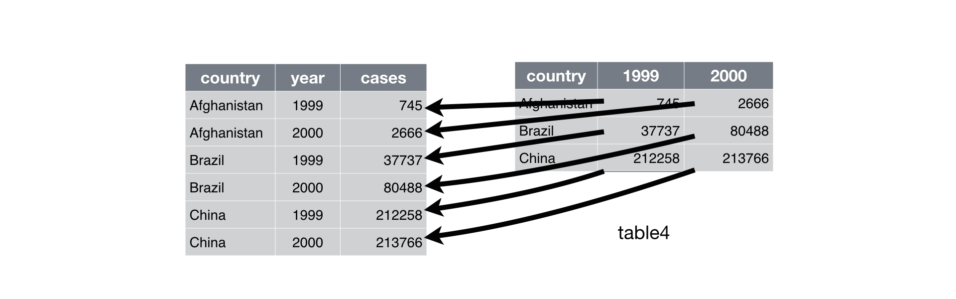
“Tidy” Data
“Untidy” Data
Data Science with R - Garrett Grolemund

Slide 55
An introduction to dplyr

Slide 56
Function | What it does
group_by() | Group data and by a factor variable for subsequent calculations
mutate() | Add a new column / variable
select() | Select specific columns / variables
summarize() | Generate summary statistics
filter() | Keep rows that match specific criteria
arrange() | Order rows by specific criteria
n() | Count number of cases
row_number() | Add a row number (type of ranking method – there are many others)

Slide 57

What is the pipe ?
df %>%
filter(sex == “male”) %>%
group_by(grade) %>%
summarize(height_x = mean(height))
Read this as “and then do this”
Why do it this way? – because it enables us to seam together data, visualization and analysis …… it’s worth the effort !

Slide 58

Example dataset:

Slide 59

Use summarize() and group_by() to get summary data for each group
nb, you can use ‘summarise’ or ‘summarize’ interchangeably

Slide 60


Slide 61

Use filter() to subset data

Slide 62

Example dataset:

Slide 63

Use mutate() to add a new variable (column)
Use select() to select specific columns in the dataset

Slide 64

Many dplyr functions can be chained together in successive rows:
This takes the data, adds an ‘avg’ column, selects specific columns, then only keeps rows where the individual had at least 50 at bats (AB), and then groups the data by year and calculates the mean, sd, median avg by year

Slide 65


The beauty of this dplyr/tidyverse approach is going from raw data to summary data to visualization in a simple chain.
Don’t worry about the visualization code right now – we cover this in the next section

Slide 66

Use n() to count number of observations per group (or groups):

Slide 67

Use arrange() to order by a variable:

Slide 68

Use arrange() to order by a variable:

Slide 69

Use summarize_at() and summarize_if() to get summary information over multiple variables

Slide 70
A very brief introduction to tidyr
So far all the datasets have been in ‘tidy’ format with observations in rows, variables in columns, and values in columns - what about if data are not in this format ?
ggplot2 wants data in a long format for plotting
Several statistical tests need data in a long format to work properly

Slide 71
Function | What it does
gather() | Convert data from wide to long formats
spread() | Convert data from long to wide formats
separate() | Convert one variable into two
unite() | Convert two or more variables into one

Slide 72

Example of an ‘untidy’ dataset
Here we are measuring anxiety levels before, during and after a therapy session
All the anxiety level values should just be in one column – this would make it tidy. Other identifying info should be in their own columns too.

Slide 73


Use gather() to convert data from a wide format to a long format

Slide 74


Use spread() to convert data from a long format back to a wide format

Slide 75


Use unite() to join variables together

Slide 76


Use separate() to separate variables into different columns

Slide 77
2. Data Visualization & Descriptive Statistics

Slide 78

ggplot2

Slide 79
ggplot2
These slides contain some basic information for creating ggplot2 figures. I am summarizing here but the tutorial code files go through step by step.
I will demonstrate code for many of the most typical plots that are made in ggplot2.
Throughout the course we will see several more examples that I do not have space to include in the slides, but all code for these examples will be provided in the additional material,.
Please see references for many other guides on how to make ggplot2 graphs.
Remember that ggplot2 figures are highly customizable – every part of the figure can be altered - we will only touch the surface of the vast number of possibilities in graphing
The focus here will be on charts used commonly when doing statistical analysis.

Slide 80


Example Dataset:
There are several functions for plotting in base-R and we will use some. An example scatterplot is below using the plot() function. These can be made beautiful (with a lot of work) However, ggplot2 gives us far more control.

Slide 81

Building up layers of a ggplot2 graph – an illustration
Example 1 - a scatterplot

Slide 82


Slide 83

geom_point() shapes – use “pch=“

Slide 84

Other common ggplot2 attributes that you may wish to set:

Slide 85

Color by grouping variable

Slide 86

To add linear trendline:
stat_smooth(method=“lm”)
To separate groups into panels:
facet_wrap(~Region)

Slide 87


There are numerous methods for setting colors. Here we set them manually using
scale_color_manual(values=c( …….))
Other options include generating a gradient of colors or using other predefined color palettes.

Slide 88


Examples of additional customization:
Axes titles
Main title
Subtitle
Annotating text on graph
Theme of plot

Slide 89

Exporting your ggplot2 figure to your computer
The .png image will be located inside your working directory

Slide 90

Making line graphs in ggplot2
Example Dataset

Slide 91

Building up a line graph in ggplot2

Slide 92


Basic line graph

Slide 93


Customized line graph

Slide 94


Overlaying individual observation data with summary data

Slide 95

ggplot2 is very versatile – here we are seeing the median life expectancy of four continents (dark blue lines) against each individual country life expectancy over a range of years (see tutorial for code)

Slide 96

Making histogram plots in ggplot2
Example data from the ‘babynames’ package – contains the total number of children born in each year with a given name and gender 1880-2015

Slide 97

Use geom_bar() if data is already in summary format (i.e. every row is a count)

Slide 98


Here using the ‘Batting’ dataset from ‘Lahman’ package, we have a dataset that has individual observations on each row (i.e. not summary frequency counts).
We can create histograms directly from this.

Slide 99

Again, these base-r plots can be modified (we’ll have some examples in the tutorial) but to create beautiful plots we should use ggplot2

Slide 100



Slide 101


Further customization of histograms
facet_wrap() – makes panel
geom_vline() – adds vertical line at .3
postion=“identity” – ensures consistency of x-scale
binwidth=.005 - determines size of each bin

Slide 102

Making boxplots in ggplot2

Slide 103


Redefining factor levels to ensure preferred order on x-axis

Slide 104


Overlaying raw data over boxplots can be a very useful way of demonstrating the distribution of data within and between groups

Slide 105


Adding a “fill” term inside “aes” allows us to compare boxplots across two factors

Slide 106


dotplot (beeswarm) plots

Slide 107


Using “stat_summary()” to overlay summary stats

Slide 108


Using “stat_summary()” to overlay summary stats

Slide 109



Slide 110

Beware of Dynamite
http://biostat.mc.vanderbilt.edu/wiki/pub/Main/TatsukiRcode/Poster3.pdf

Slide 111

Beware of Dynamite
http://biostat.mc.vanderbilt.edu/wiki/pub/Main/TatsukiRcode/Poster3.pdf

Slide 112


Making dynamite plots in ggplot2
The easiest way to do this is to summarize data first using e.g. dplyr, and then produce the graph.

Slide 113


Use geom_bar() to plot means across groups
Use geom_errorbar() to plot error bars
Using fill=pop_grp means we are plotting 2 bars per region (one for ‘high’ and one for ‘low’).
We therefore use ‘postion=position_dodge()’ and stat=“identity”
to put them side by side rather than having them stack on top of each other

Slide 114


Likewise, for line graphs – we just need to summarize the data first
We can use geom_errorbar()

Slide 115

Sometimes using ribbons (shaded regions) rather than error bars are more aesthetically pleasing.
This can be done using geom_ribbon()

Slide 116

Chaining
One last thing… - the beauty of the pipe is that we don’t have to reassign subsetted data to a new object before plotting. We can go directly from the raw data to the plot like this:
Here we just directly chain the dplyr operations with the ggplot2 operations
No need to tell it what data to use – it uses what comes immediately before it in the chain

Slide 117
3. Parametric Statistics

Slide 118
3a. Testing normality and variances of distributions
Parametric statistics often have specific assumptions. Two common ones are that data are normally distributed and there is homogeneity of variance across groups.

Slide 119

1. Visual inspection of the normality of the distribution
Example dataset shows the hygiene level (lower scores = worse) for festival goers over 3 days of a festival.

Slide 120


To a histogram plot – we can add a normal distribution curve for a given mean and standard deviation
This enables us to make some informed decisions about the likelihood of the data being normally distributed.

Slide 121



2. The QQ plot plots the cumulative values of our data against the theoretical cumulative values from a normal distribution
Large deviations from a straight line are indicative of a non-normal distribution (some tailing off at the extremes is typical)

Slide 122


The library ‘patchwork’ provides a nice way of putting multiple variables next to each other
Here day2 and day3 appear to have non-normally distributed data

Slide 123


3. We should also examine the kurtosis and skewness of the distributions
These can be done using the following functions:

Slide 124


Slide 125

Example Dataset:

Slide 126

When using statistics that compare across individual groups, it is important to check that data is normally distributed within each group - this can be done using by() as we saw earlier:

Slide 127


4. Shapiro-Wilk Test - Testing if a distribution could come from a normal distribution of a given mean and SD.

Slide 128

As with skewness and kurtosis, we should also perform the Shapiro-Wilk test across groups:

Slide 129

There are many ‘normality’ tests – and different software packages include different versions. Most people recommend using Shapiro-Wilk, however, here is a quick summary of how to perform some of the other commonly requested normality tests:

Slide 130


5. Levene’s Test for Homogeneity of Variance
Use the leveneTest() function from the package ‘car’:
An alternative is to calculate Hartley’s Fmax (see additional material)

Slide 131
3b. Paired and unpaired T-tests

Slide 132

Example Dataset:

Slide 133


The function t.test() can be used for all t-tests (one-sample, two-sample, paired and unpaired)
A one-sample t-test:
When performing quick statistical procedures, it’s often easiest to make quick base-r graphics. Here, we are using boxplot() to plot a boxplot.

Slide 134


Use wilcox.test() for a non-parametric alternative to one-sample t-test:

Slide 135



The tilde can be pronounced as “is predicted by”
Independent t-tests:
Note: R automatically applies the Welch’s correction for unequal variances between groups
R output includes confidence intervals of true mean difference

Slide 136
Independent t-tests:
Note: R automatically applies the Welch’s correction for unequal variances between groups
You can perform the independent t-test by removing Welch’s correction – though in practice this isn’t a good idea. There is no real benefit to removing it when variances are equal – so best to keep in place.

Slide 137

Independent t-tests:
To perform a one-tailed test, you need to add the argument alternative=“less” or alternative=“greater”

Slide 138


Calculating Effect Sizes
$$r=\sqrt{\frac{t^{2}}{t^{2}+df}}$$
We can calculate the effect size a t-test using the formula

Slide 139


Use wilcox.test() for a non-parametric alternative to independent t-test:

Slide 140

Performing multiple t-tests at once using lapply()
Note – this does not apply any correction to the p-value threshold
Whether running multiple tests is satisfactory is a researcher decision

Slide 141


Use pairwise.t.test() to perform multiple t-tests between levels of a factor and adjust p-value

Slide 142



Add paired=TRUE to perform a paired t-test between two vectors
Add paired=TRUE to the wilcox.test() for the non-parametric equivalent

Slide 143
3c. Between-Subjects ANOVA
One-Way ANOVA
Analysis of Covariance
Two-Way ANOVA

Slide 144



Example dataset:
Prior to an ANOVA, you should visualize data and perform checks of assumptions

Slide 145

Use aov() to produce a model
aov() is a simple method of generating the typical statistical output for a one-way ANOVA

Slide 146


Checking diagnostic plots using plot()
For all ANOVAs and regression models we can use plot() to investigate diagnostics.
In brief, the two plots on the left side are examining if there residuals vary across fitted values.
The top-right plot is the typical QQ plot.
The bottom-right is a plot that examines leverage of individual points (we discuss more in linear regression module).

Slide 147

Use oneway.test() to produce a model that includes a correction for unequal variances (heterogeneity)

Slide 148

Planned Contrasts -
If you wish to perform some planned contrasts (or comparisons), you can set the contrasts of a variable. Using this method, you would perform a linear regression (which is equivalent to an ANOVA in this case) using the function lm()
This is the output using lm()
Notice how the F-statistic, degrees of freedom and p-value of the overall model are identical to that using aov()
aov() is just lm() in disguise !

Slide 149

Wrap the lm model in anova() to get the typical ANOVA summary

Slide 150

Planned Contrasts -
Use contrasts() to identify the current groupings of a variable. This dictates what comparisons the model makes. If you wish to set your own, there are some important rules.
The sum of each contrast must equal 0
Assign weights negatively and positively to differentiate groups that you wish to compare.
Use a weight of 0 to ignore/exclude a group from comparisons.
Here, contrast1 is comparing placebo (-2) to low (+1) and high (+1) dose combined.
Contrast2 is comparing the group low dose (-1) to the group high dose (+1) whilst ignoring placebo (0).

Slide 151

Planned Contrasts
Notice how the output now has our planned contrasts for the individual coefficients.
Note that these p-values are 2-tailed so can be halved to 1-tailed because of our planned comparisons.
The other overall model statistics are still the same.

Slide 152


Planned Contrasts
R has some other built in planned contrast methods.
One useful one is contr.poly()
This can be used to determine if there is a linear relationship or quadratic (curvilinear).

Slide 153

Posthoc Testing
If we did not have planned comparisons, we could do posthoc testing.
As we saw earlier, we could perform pairwise comparisons adjusting our p-values using pairwise.t.test()

Slide 154

Posthoc Testing
Use TukeyHSD() to perform the Tukey’s Honestly Significantly Different posthoc tests

Slide 155

Posthoc Testing
If you require alternative posthoc testing methods (there are many) then you could use the library ‘multcomp’.
The function glht() performs several other posthoc tests including Dunnet’s posthoc test.

Slide 156

Effect Sizes and Model Statistics
The package broom has several useful helper functions to get model summaries including effect sizes
glance() will give us effect sizes (r.squared) as well as sigma, AIC, BIC, deviance. These can all be used to assess model fit. We discuss this more later.
tidy() gives us information about the ANOVA model in a tidy dataframe format.

Slide 157

Effect Sizes and Model Statistics
Other packages also exist to give us some of these same model effect sizes and more.

Slide 158


Coefficient Effect Sizes
$$r=\sqrt{\frac{t^{2}}{t^{2}+df}}$$
We can calculate the effect size of individual estimates using the same formula as for the t-test
Here we make a function rcontrast() that we can use to get the effect size for contrast1 placebo vs low+high dose

Slide 159

What to do if assumptions are not met ? - 1. you could try non-parametric alternatives

Slide 160

What to do if assumptions are not met ? - 2. might be better to try e.g. random sampling methods

Slide 161


Analysis of Covariance
Example Dataset
We may wish to perform an analysis of Covariance when we are interested in the effect of some predictor on a response variable but we wish to control for another potentially confounding variable.
For instance here Dose does not predict libido, but we have not accounted for the potentially confounding variable Partner_Libido

Slide 162


An important assumption of the ANCOVA (in addition to other assumptions that we have previously discussed) is that the predictor variable (dose) and the covariate (partner_libido) are independent.

Slide 163

R uses type I sequential sums of squares - any predictor entered into a model is evaluated only after prior predictors.
There are several types of ANOVA method:
Type 1: Sequential method.
Type 2: All predictors are evaluated after taking into account all others except interactions.
Type 3: All predictors are evaluated after taking into account all others.
Type 4: (similar to type 3 but accounts for missing data)
Recommendation:
Type 1: Unless predictors are completely independent (unlikely) not very useful.
Type 2: If interested in MAIN EFFECTS only.
Type 3: Default for most stats packages - better with uneven sample sizes and interactions.

Slide 164
Adding in the covariate to the model appears to be straightforward but note something very important
The ORDER in which the covariate is added makes a big difference to the model - why ?
R uses type I sequential sums of squares - any predictor entered into a model is evaluated only after prior predictors.
There are several types of ANOVA method:
Type 1: Sequential method.
Type 2: All predictors are evaluated after taking into account all others except interactions.
Type 3: All predictors are evaluated after taking into account all others.
Type 4: (similar to type 3 but accounts for missing data)
# Type 1: Unless predictors are completely independent (unlikely) not very useful.
# Type 2: If interested in MAIN EFFECTS only.
# Type 3: Default for most stats packages - better with uneven sample sizes and interactions.

Slide 165

Unless you specifically want to calculate your Sums of Squares using an alternative method, the best solution is to convert model results to Type III results using the Anova() function from the ‘car’ package.
Notice how both of these models now give the same results

Slide 166

Planned Contrasts
We can perform planned contrasts as before

Slide 167

Adjusted Means
Using the function effect() from the ‘effects’ package we can calculated the adjusted means
These are means that are adjusted for the influence of the covariate.

Slide 168

Identifying which Adjusted Means differ using Planned Contrasts

Slide 169

Identifying which Adjusted Means differ using Posthoc tests

Slide 170

Homogeneity of Regression Slopes
In addition to the standard diagnostic plots we should also check homogeneity of regression slopes
This means that the relationship between the covariate and the outcome variable should be consistent across predictor groups
This plot is clearly problematic – the relationship for ‘high-dose’ is different to the other two

Slide 171

Homogeneity of Regression Slopes
We can identify this lack of homogeneity of regression slopes by identifying a significant interaction term in this model

Slide 172

Effect Sizes for the Model
As we saw earlier, effect size for the model can be calculated in the same fashion

Slide 173

Effect Sizes for the Coefficient Estimates
These can also be calculated in the same manner as we saw earlier by converting the t-statistics to an r-statistic.

Slide 174

Two-Way ANOVA
Factorial ANOVAs are when there are more than one predictors (independent variables) in the model.
This example dataset looks at the extraversion of males and females after no alcohol, 2 or 4 pints of alcohol.
The predictors are gender and alcohol group. The response or outcome variable is extraversion.

Slide 175



Visualization of Data
Visualization of the data suggests that there is an effect of alcohol on extraversion, but only for males and only for the 4 pints group

Slide 176

As with other ANOVA we have to check assumptions
For the Levene Test we should examine homogeneity of variances across all potential interactions.
We do this by adding in the term ‘interaction’ into the function.
Other diagnostic tests should be performed as described earlier (also see tutorial scripts).

Slide 177

Setting planned contrasts - following same rules as outlined earlier

Slide 178

An interaction term can be added in to the aov() function using the * notation

Slide 179

We can evaluate model statistics and effect sizes using the same methods as before (see earlier)

Slide 180

The anova_stats() function from the ‘sjstats’ package gives lots of useful output too:

Slide 181

We can also evaluate planned contrasts in the same way as before (see earlier)
It is clear here that there are significant interactions between alcohol and gender – these should take priority in our evaluation over any main effects.
(It’s also possible to run posthoc tests similar to those described before – see tutorial scripts)

Slide 182


Visualizing planned contrast interactions

Slide 183

Individual estimate effect sizes are calculated as before (see earlier)

Slide 184
3d. Repeated-Measures ANOVA
For a repeated-measures ANOVA (also called within-subjects ANOVA), we have several observations on the same subjects.

Slide 185

Conceptually data for repeated-measures ANOVA often are in wide format.
In R, we like to have ‘tidy’ data, so convert to long format using tidyr.
These data show the length of time (in seconds) it took to retch for different participants eating four different foods.

Slide 186

We should visualize our data, as well as examine our data for normality, skewnewss, kurtosis

Slide 187

The basic approach is to use aov() and include an Error term – this tells the model that the variable ‘Animal’ is nested within the variable ‘participant’ - this will ensure that aov() performs a repeated-measures ANOVA.

Slide 188

Effect sizes: “generalized eta-squared”
This model can also be run using the ezANOVA() function in the ‘ez’ package. The advantage of this is that it also assesses sphericity
– an assumption of the model is that the variances of the differences between all groups are equal
Here sphericity cannot be assumed as p<.05 for the Mauchly’s test – but it also provides corrected values using the Greenhouse-Geisser and Huynd-Feldt methods. A good rule of thumb is to take the average of these p-values as to whether the model is significant.

Slide 189

pairwise-t-test can be used for posthoc tests

Slide 190

Multilevel Approach to Repeated-Measures ANOVA
Alternatively, we an use a multilevel approach – this means that we can ignore sphericity.
As before – we can assign planned contrasts using the same rules:

Slide 191

We use lme() from the package ‘nlme’ to run this approach.
Importantly, we are setting a random effect parameter in the model using:
random = ~1|participant/animal
This in effect tells the model that individuals may vary in their propensity to retch and that scores across animals are connected by participant
The summary output gives us a lot of information. Of note, are the fixed effects – these are our planned contrasts. These can be interpreted similarly to those we’ve seen in other models.
We can also use this information to calculate estimate effect sizes as before

Slide 192

To investigate whether there is a main effect of “animal”
– i.e. does including the group means of ‘animal’ in the model make a better fit of the data?
Here we create a baseline model by excluding the ‘animal’ predictor – in its place we put ‘1’ indicating keeping the intercept.
We use anova() to compare the models directly. Of note, we see that the AIC and BIC are lower for the model including ‘animal’. (two measures of the fit with smaller values being a better fit – see regression section).
The likelihood ratio test is also significantly different between the two models, so including ‘animal’ does improve fit – indicating that ‘animal’ has a significant effect on the outcome variable Retch.

Slide 193

Posthoc tests for repeated-measures ANOVA
We can compute Tukey post-hoc tests (among others) using the ‘multcomp’ package.

Slide 194


Repeated-Measures for Factorial Designs
The same principles we saw in the one-way ANOVA can be used in a factorial design

Slide 195

Using ezANOVA()

Slide 196

Posthoc testing from exANOVA() model

Slide 197

Multilevel Approach
Here we build up the model one step at a time using update() – this allows us to compare models to each other to find the best fit.
In the random effect, we have to specify that both drink & imagery are nested within participant.
Planned contrasts can be performed in the same manner as before (see additional tutorial code for more information)

Slide 198
4. Correlation & Regression

Slide 199
4a. Pearson and Spearman Correlation

Slide 200


Example dataset

Slide 201

Get overview of variables of interest using base-r

Slide 202

Use the ggscatmat() function from the GGally package to get an overview in a ggplot2 style – this includes Pearson correlation coefficients by group

Slide 203

The ggpairs() function from the same package allows you to compare across continuous and discrete variables

Slide 204


Use cor() to get correlation matrices or specific correlations between variables
Pearson, Spearman and Kendall (Tau-B) methods are available.

Slide 205

Use cor.test() to run a significance test
Adding in alternative = “less” etc. dictates a one-tailed test as cor.test() is 2-tailed by default.

Slide 206

Use rcorr() from the ‘Hmisc’ package to get a matrix of correlation tests:

Slide 207

Use corr.test() from the ‘psych’ package to get a matrix of correlation tests with adjusted p-values:

Slide 208

Partial Correlations
When we have 3 variables that are clearly interrelated, but we are interested in the relationship between 2 of them, we can use a partial correlation to get and adjusted correlation coefficient accounting for their relationship with a third variable.

Slide 209

Use pcor() from the ‘ppcor’ package to get a matrix of partial correlation tests
Partial correlation tests need complete observations across variables.

Slide 210

Point-Biserial Correlations
Point-biserial correlations can be used to determine whether there is a correlation between a discrete dichotomous variable (e.g. gender) and a continuous variable (e.g. time).
Here we are investigating whether male cats (1) spend more hours per week (time) away from home than female cats (2)

Slide 211

Point-Biserial Correlations
There are several options for running point-biserial correlations in R, each using slightly different algorithms.
Probably best to use the polyserial() function from the ‘polycor’ pacakge.

Slide 212
4b. Linear Regression

Slide 213



Slide 214


We can use a linear regression model to determine the linear relationship between two continuous variables.
Our model will determine a) the intercept, b) the coefficient of the slope of the trend line, and e) have some error
Y = a + bX + e

Slide 215


Use lm() to build the basic linear regression model
R² and the Residual Standard Error are useful measures of goodness-of-fit of the model

Slide 216

Use anova() to test if model fits data better than zero slope model
Other measures of goodness-of-fit include AIC and BIC

Slide 217


Use predict() to calculate predicted values of Y based on values of X

Slide 218


Use add_predictions() from the ‘modelr’ package to add predictions to a dataset

Slide 219

Residuals
Raw residuals as well as standardized residuals and studentized residuals can be obtained from the model object.

Slide 220


Checking assumptions
Assumption: Linear relationship between X and Y

Slide 221


Assumption: Homoscedasticity of residuals
Top-left: fitted values (x) against residuals (y) - also tests for non-linearity
Bottom-left: fitted values (x) against square-root of standardized residuals (y)
Expect an approximately flat red line (no overall pattern) for both if homoscedasticity
Assumption: Normality of residuals
Top-right plot = Normal QQ plot
If points lie exactly on the line then they come from a perfectly normal distribution. Some deviation is expected, particularly at the tails. Can also test using shapiro.test()

Slide 222



Leverage - a measure of how much the predicted value would change if the observation is moved one unit in the y-direction

Slide 223



Slide 224

Use the ‘broom’ package to get model summary information including for observations

Slide 225
Validating models using Training/Testing Data
A common approach to validating models is to develop a model using a proportion (e.g. 80%) of the original data and to then test it on the remaining out-of-sample data.
By comparing the mean square errors of the out-of-sample data to the in-sample (training) data, it’s possible to evaluate the goodness of fit of a model.
In more complex models, this avoids over-fitting a model to the data.

Slide 226

Procedure for validation

Slide 227

Here we can see that the mean square error appears higher in the test out-of-sample data compared to the training data, which might be cause for concern about the fit of our model.

Slide 228

Multiple Regression
In multiple regression we include multiple predictors in the model. This requires each predictor to have it’s own estimate.
Here we are trying to predict sales based on money spent on TV, radio or newspaper advertising.

Slide 229

Models can be made using lm() and summary information can be derived as before.
Each predictor is included on the right hand side of the ~ in the model formula.

Slide 230

Compare multiple regression to simple linear regression:
Model 2's R²=.90 is much higher than that for model1 indicating that model2 explains more of the variance in sales. More importantly the adjusted R² is higher (this is adjusted for the number of predictors in the model).
The RSE (sigma) of model 2 is lower than model 1 showing that we have reduced the variance of our parameters.
The AIC and BIC are also substantially lower in model 2.

Slide 231

Diagnostic plots should be made as described before – here model 2 appears to have issues with heteroscedasticity

Slide 232

Diagnostic plots should be made as described before – here model 2 appears to have issues with residuals not being normally distributed

Slide 233

Including interactions in the model

Slide 234

Collinearity
When one or more predictor variables in a multiple regression model can be linearly predicted from the others then we have collinearity
Example dataset:

Slide 235


Collinearity
In the second model we have collinearity between limit and rating - this has caused the standard error of the estimate to increase dramatically meaning the result is no longer significant
Identify collinearity by examining correlation matrix of predictors

Slide 236

Multicollinearity
Also possible that no correlation will exist between any two predictors, but three or more variables may be highly interrelated – this is multicollinearity.
Can be tested in R using the vif() function from the ‘car’ package.
VIF is the variance inflation factor – if it is close to 1 then it suggests no collinearity. If it is >5 then there is high collinearity. If it is between 1 and 5 then there is some collinearity.

Slide 237


Partial F-test to test if variables add substantially to a model
Use anova() to compare models.
Appears ‘sqft’ is the only variable needed to predict price

Slide 238

Model Selection
Deciding which predictors/variables to include in a model can be difficult.
There are however some automatic model selection methods that can assist with this.
The package ‘leaps’ has some of these – we will discuss two: Best Subset Selection and Stepwise Selection.
Example Dataset

Slide 239

An example – forward stepwise selection

Slide 240



Plots to evaluate model fit

Slide 241


Using an out-of-sample dataset to evaluate model selection.

Slide 242
4c. Logisitic Regression
We use the logistic regression when the response (outcome) variable is discrete and error terms do not follow the normal distribution.

Slide 243



Plotting data and adding a logistic regression fit curve

Slide 244

Use glm() to perform a generalized linear model and family=“binomial” to set as a logistic regression

Slide 245

If the (residual) deviance is substantially reduced compared to the null deviance then suggests model is a good fit

Slide 246

Estimates can be hard to interpret in logistic regression as they are log odds.
Here, a one unit increase in balance is associated with an increase in the log odds of defaulting of 0.0057 units.
However, exponentiating the coefficients – a one dollar increase in monthly balance is associated with a 1.0057 increase in risk of defaulting.

Slide 247

Can use predict() to make predictions.
Here the results are provided in probabilities –
So a monthly balance of $2000 leads to a 58.2% likelihood of defaulting all other things being equal.

Slide 248


Generating the logistic regression plot in base-r

Slide 249

Example including categorical variables in a logistic regression

Slide 250

Notably the increase in probability for defaulting if a student is very small even though it’s significant.

Slide 251


Multiple logisitic regression
Potentially some collinearity:

Slide 252

Using predict() to make predictions for multiple logistic regression.
Here, students are about half as likely to default as non-student for given income and balance.

Slide 253

Logisitic Regression Model Diagnostics
Likelihood Ratio Test to Evaluate if our models are improving the fit of the data:

Slide 254

Although there is no R² statistic for a logistic regression, we can calculate McFadden's R² which can be used as an approximation. We use the function pR2() from the 'pscl' package.
McFadden's R² ranges from 0-1 but is highly unlikely to ever get to 1. Indeed, a McFadden's R² around .40 indicates a very good fit.

Slide 255


Residuals
Although residuals do not have to be normally distributed and variances does not have to be constant across groups for logistic regression – it is worth checking standardized residuals. Those that are above 3 (or below -3) may be possible outliers.

Slide 256


As with other models, we can look at Cook’s distances to identify points with high leverage

Slide 257


Evaluating classification success
If we use a validation method (training/testing) we can identify the success of our model on the out-of-sample test data.
Here, for model1, 96.2% of cases are true negatives. 1% of cases are true positives. 2.5% are false negatives, and 0.3% are false positives.
We have a lower error rate (only 12/3815) were wrongly classified as not defaulting.
But low precision – as only 40/138 were correctly identified as defaulters.

Slide 258
5. Generalized Linear Models

Slide 259
Poisson Regression
In a Poisson Regression, the response variable are the number of occurrences (frequency) of an event with no upper bound. The response variable must allow for counts of 0 however.
e.g. number of aggressive acts per animal
e.g. number of awards earned by each student in a high school
e.g. number of robberies per month
Typically these types of data the distribution is such that often the mode value is 0, the next most common is 1, then 2 etc. Transforming data in any way monotonically will never shift the mode to the middle of the distribution.
Also count data are bounded by 0 as a lower limit - linear regression assumes a continuous response variable -infinity to +infinity
As count data often fall into a Poisson distribuion, a poisson regression can be used. As with logistic regression - poisson regression uses maximum likelihood estimation, and we transform the response variable (Y) via a link function. The link function in natural log (so need to transform coefficients back for interpretation).

Slide 260



Example dataset – number of matings by elephants by age.
The histogram illustrates the skewed distribution of the data.

Slide 261

We can use a Poisson regression to investigate the relationship between Age and Matings.

Slide 262


Use glm() to build the model
One important thing to note is the relationship between residual deviance and degrees of freedom. If the residual deviance is much higher than the d.f. then suggests over-dispersion (variance not being accounted for by the model).
Here 51.01 > 39 - this is a ratio of 1.3. Some suggest up to 1.5 is ok, others suggest it needs to be close to 1.0

Slide 263


We can use the usual functions in the package ‘broom’ to retrieve model summary information.
Positive coefficient for Age indicates that as Ages increases so does Matings.
Exponentiating the coefficients shows that for a 1 unit increase in Agem there is a 7.1% increase in matings, or there will be an increase in matings of 1.07 times.

Slide 264


Use predict() to obtain predicted values to plot trendline

Slide 265


Another assumption of a Poisson regression is that no observed counts should be substantially more or less than those expected from a Poisson distribution. That is, there should not be substantially more 0s (or 1s, 2s) than expected by a Poisson distribution with a given mean.
Use dpois() to generate observed values for our mean, and then ggplot2 to plot

Slide 266

Visually this can be helpful, though can also perform a Chi-squared test to test whether the distributions (observed vs expected) are similar:

Slide 267

Pearson's Χ² dispersion statistic (Hilbe 2011)
An additional check is the Pearson Χ² dispersion statistic as described by Hilbe.
A value of 1 indicates that the variances of the observed and predicted variables are the same, and a value over 1 indicates that there is over-dispersion.
Hilbe recommends overdispersion if value is >1.25 for moderate sized models, and >1.05 for large numbers of observations (Hilbe p82 Modeling Count Data 2016).
The msme package has a function P_disp() that performs this test.

Slide 268

Deviance Goodness of Fit Test
We can also test how much variation in observed vs predicted outcomes we should expect if our model is a good fit of the data.
The deviance follows a chi-squared distribution, with df = n - p (n is number of observations, p is number of parameters)
Here we have reason to believe that we cannot reject the null hypothesis that our model is correctly specified – so this suggests our model is a good fit.

Slide 269


Scale-Location Plot
This plot examines whether the model is correctly scaling the variance with the mean. It should be an approximately even scatter of points, with a fairly straight line through it.

Slide 270

Quasi-Poisson Regression
If our Poisson Regression is not suitable for our data – one option is to use a quasi-Poisson regression that adjusts for overdispersion.
This can be undertaken by adding to the model:
family = “quasipoisson”

Slide 271


Negative Binomial Regression
An alternative approach for over-dispersed data may be to use a negative binomial regression.
The variance of a negative binomial distribution is a function of its mean and an additional parameter k (dispersion parameter).
Use the function glm.nb() from the package ‘MASS’ to run a negative binomial regression.

